Slide 1
MANAGEMENT SCIENCE FOR ENGINEERS

Slide 2
UNIT-I INTRODUCTION

Slide 3
INTRODUCTION TO MANAGEMENT
Management concept is comprehensive and covers all aspects of business. In simple words, management means utilizing available resources in the best possible manner and also for achieving well defined objectives.

Slide 4
Definitions of Management
According to Henry Fayola, "To manage is to forecast and to plan, to organize, to command, to coordinate and to control".
According to Harold Koontz, "Management is the art of getting things done through and with people in formally organized groups”.
According to F.W.Taylor , " Management is knowing exactly what you want men to do and then seeing that they do it the best and cheapest ways ".

Slide 5
NATURE AND FEATURES OF MANAGEMENT
1.Management is a group activity
2.Management is objective oriented
3.Optimum utilization resources
4.Decision making
5.Dynamic in nature
6.Multi-disciplinary

Slide 6
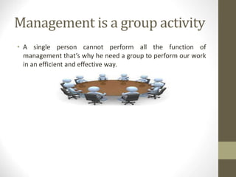
Management is a Group Activity
Optimum utilization of resources is a concept in Economics and Management and can be applied in businesses. Management principles are helpful in the optimum utilization of resources. Optimum Utilization of resources means using the resources available at hand and making best use of them.

Slide 7
Decision making is the process of making choices by identifying a decision, gathering information, and assessing alternative resolutions.
Management is a dynamic process because it keeps on changing with the changes that takes place in environment. It is continuous process because it is the act of coordinating the efforts of people to accomplish desired goals and objectives using available resources efficiently and effectively.
Multidisciplinary Management is multidisciplinary because it includes knowledge/information from various disciplines- economics, statistics, maths, psychology, sociology, ecology, operations research, history, etc. Management integrates the ideas and concepts taken from these disciplines and presents newer concepts which can be put into practice for managing the organizations.

Slide 8
IMPORTANCE OF MANAGEMENT
Achievement if objectives
Increasing productivity
Facing competition
Exercising positive influence
Modern and scientific innovation
Management necessary to all organization

Slide 9
FUNCTIONS OF MANAGEMENT

Slide 10
Management is the process of planning, organising, staffing, directing, and controlling the available resources effectively and efficiently for achieving the goals of the organisation. These interrelated elements of the management process are called functions of management.
Functions of management are differentiated into two parts managerial function (i.e., planning, organising, staffing, directing, and controlling ) and operative function (i.e., production, marketing, purchasing, financing, and personnel).
Managerial functions are common to all enterprises because it does not vary from one organisation to another. For example, planning is common in all organisations.
Whereas operative functions are not common, and they differ from one organisation to another. For example, production is not performed in a retail store.

Slide 11
FUNCTIONS OF MANAGEMENT
Koontz and O’Donnell have given a very convenient classification of management functions that are generally accepted they are:
Planning
Organising
Staffing
Directing
Coordinating
Controlling

Slide 12
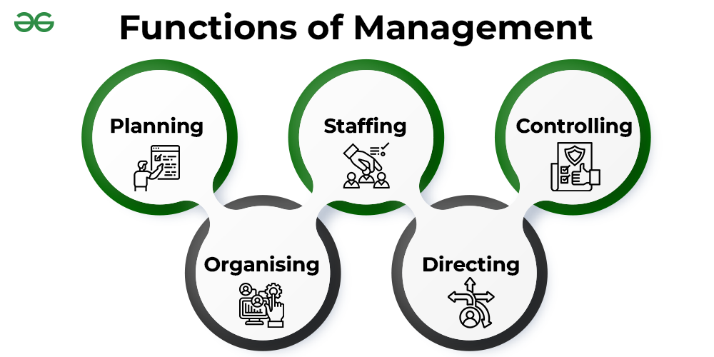

Slide 13
POSDCORB
POSDCORB is an acronym which means Planning, Organizing, Staffing, Directing, Coordinating, Reporting and Budgeting which was first coined in a paper on administrative management that was written for the Brownlow Committee by Luther Gulick and Lyndall Urwick.
POSDCORB can be used as a systematic framework for efficiently executing business processes in a company or by an individual.

Slide 14
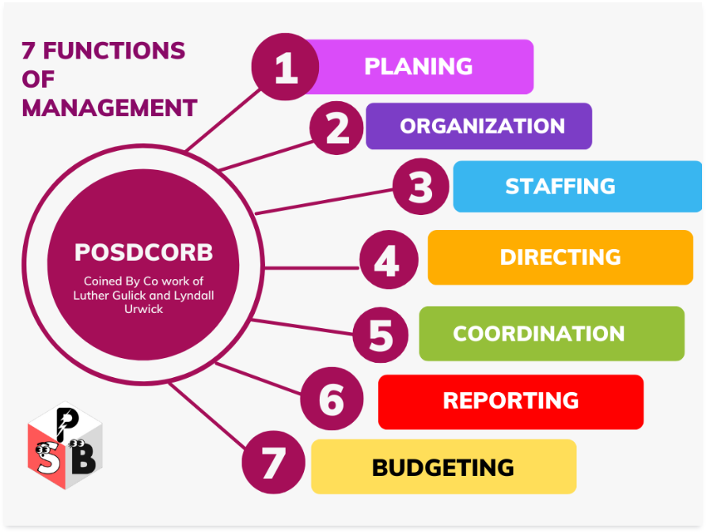

Slide 15

PLANNING
Involves selecting the objectives and actions to achieves them planning stage involves decision making and choosing future courses of action from the various alternatives.

Slide 16
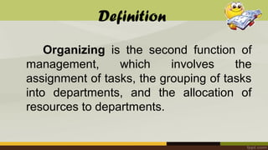
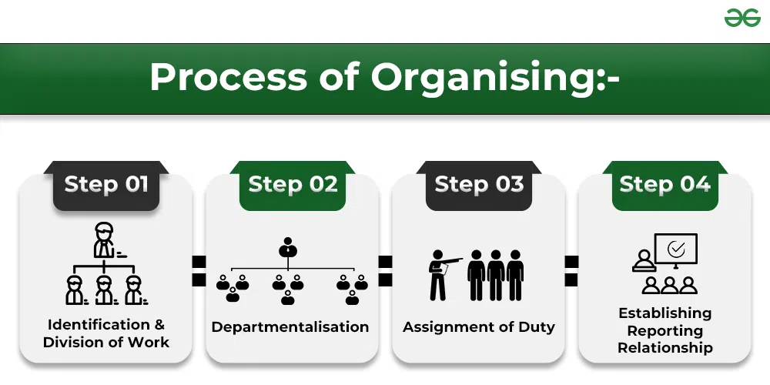

Slide 17

STAFFING
Staffing function includes keeping the various organizational position fixed. This activity is done by identifying work force requirements, keeping the records of the performance of people working with the organization.

Slide 18

DIRECTING
Directing means influencing people, so that they will contribute to the organization targets directing involves motivation, leadership styles and proper communication.

Slide 19

COORDINATING
Coordination harmonizes synchronizes and unifies individual efforts for better action and for the achievement of business objectives.

Slide 20
CONTROLLING
It is the process of comparing the plans with the results. If there is deviation attain taken to be bridge the gap between plan and actual results.

Slide 21
REPORTING
Reporting involves regularly updating the superior about the progress or the work related activities. The information dissemination can be through records or inspection.
BUDGETING
Budgeting involves all the activities that under Auditing, Accounting, Fiscal Planning and Control.

Slide 22
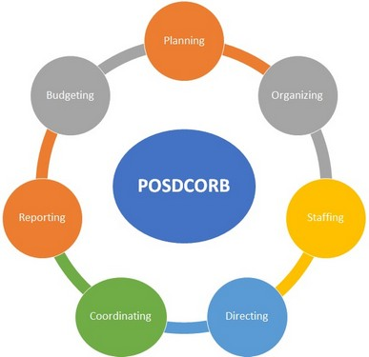

Slide 23
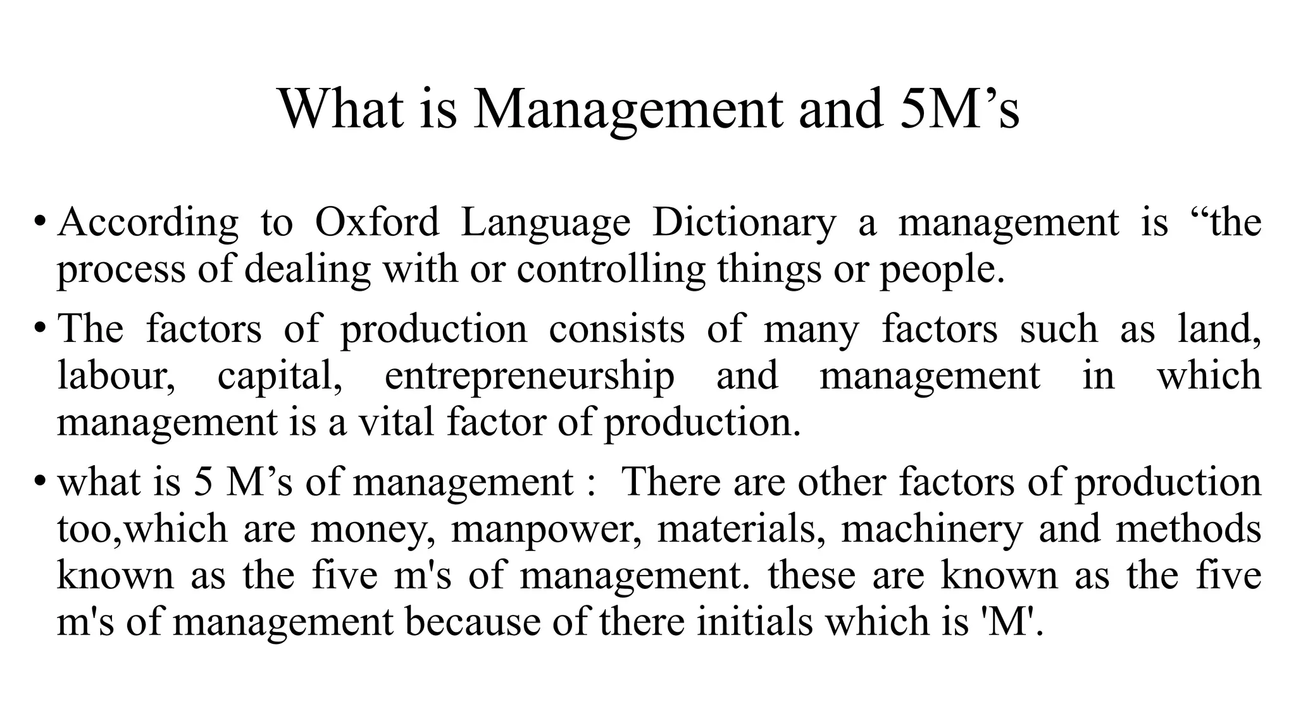

Slide 24
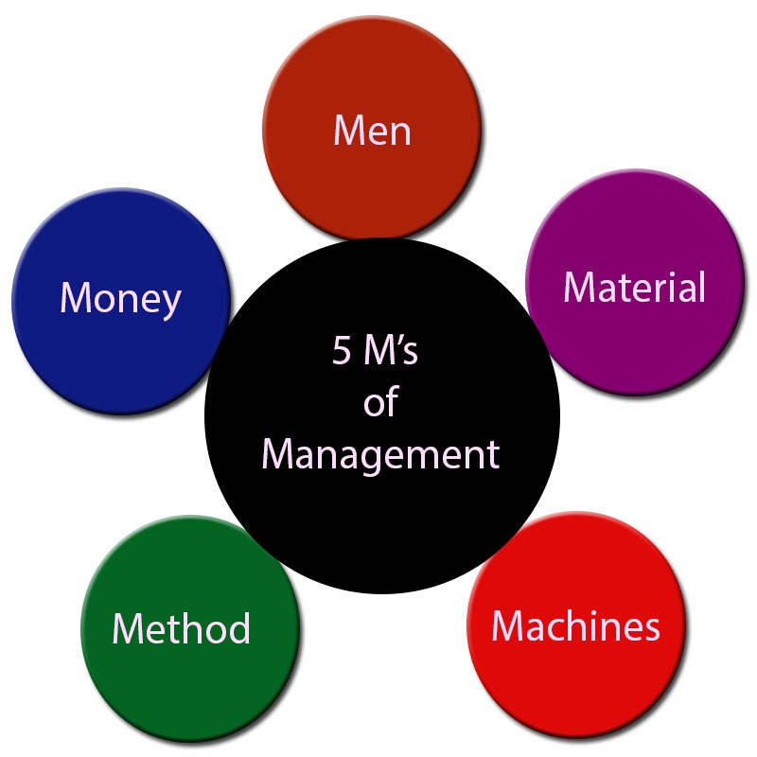
5M’S MANAGEMENT

Slide 25
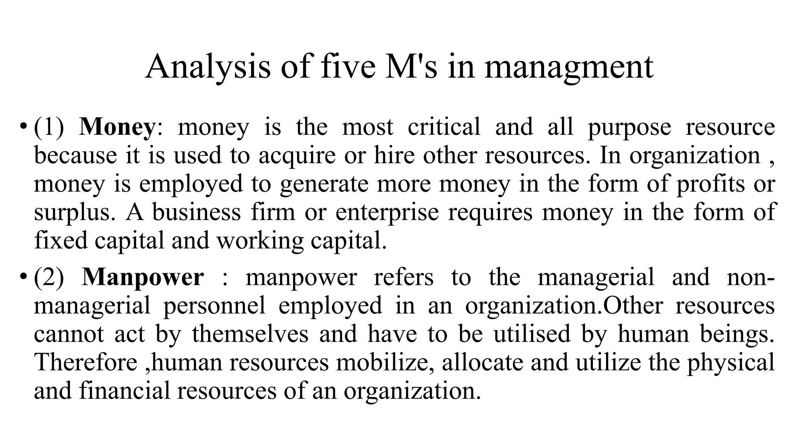

Slide 26
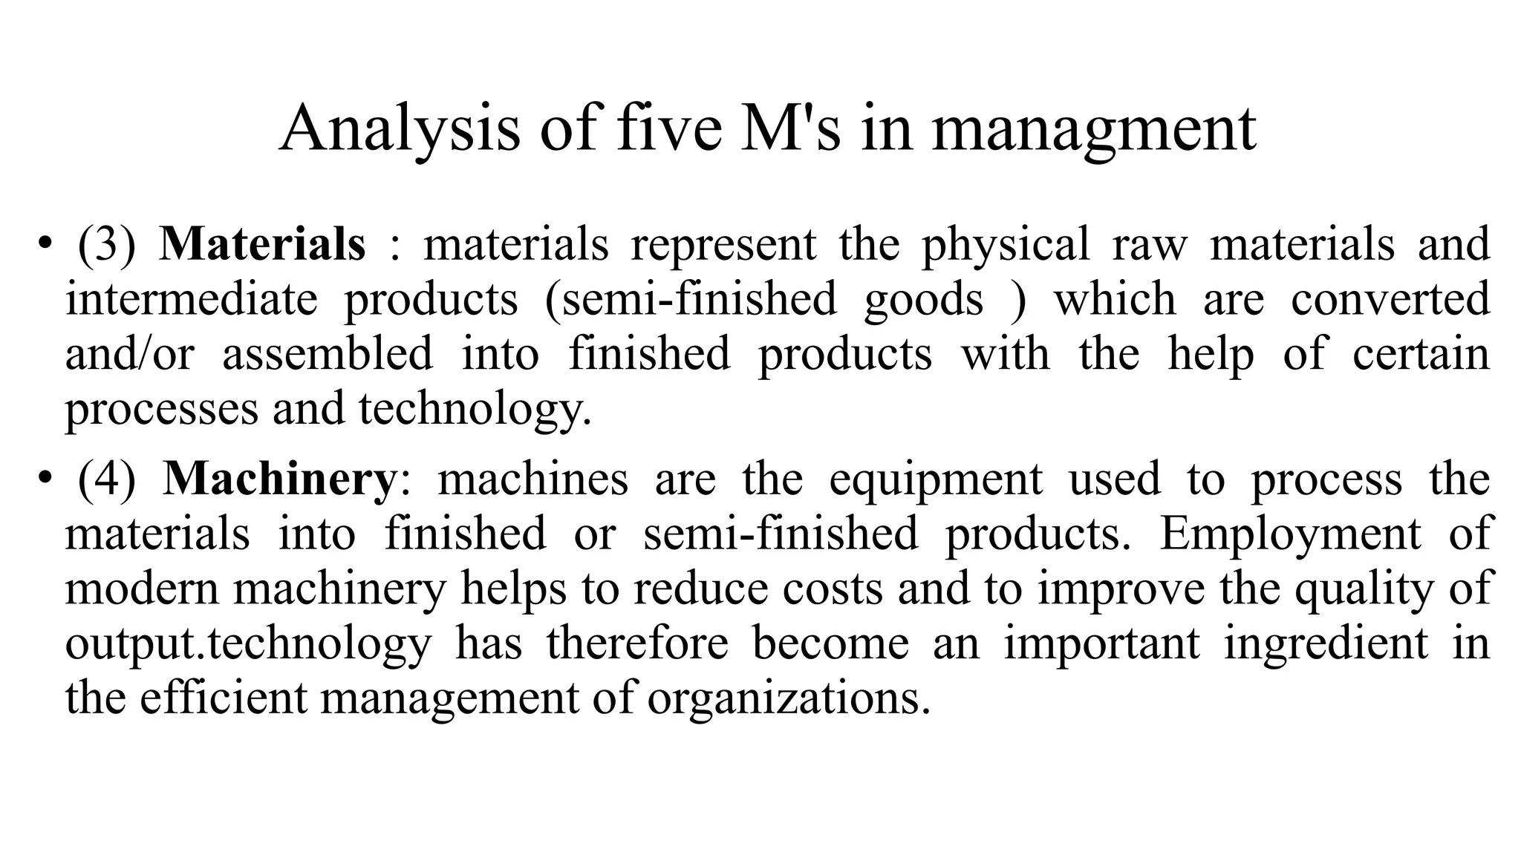

Slide 27
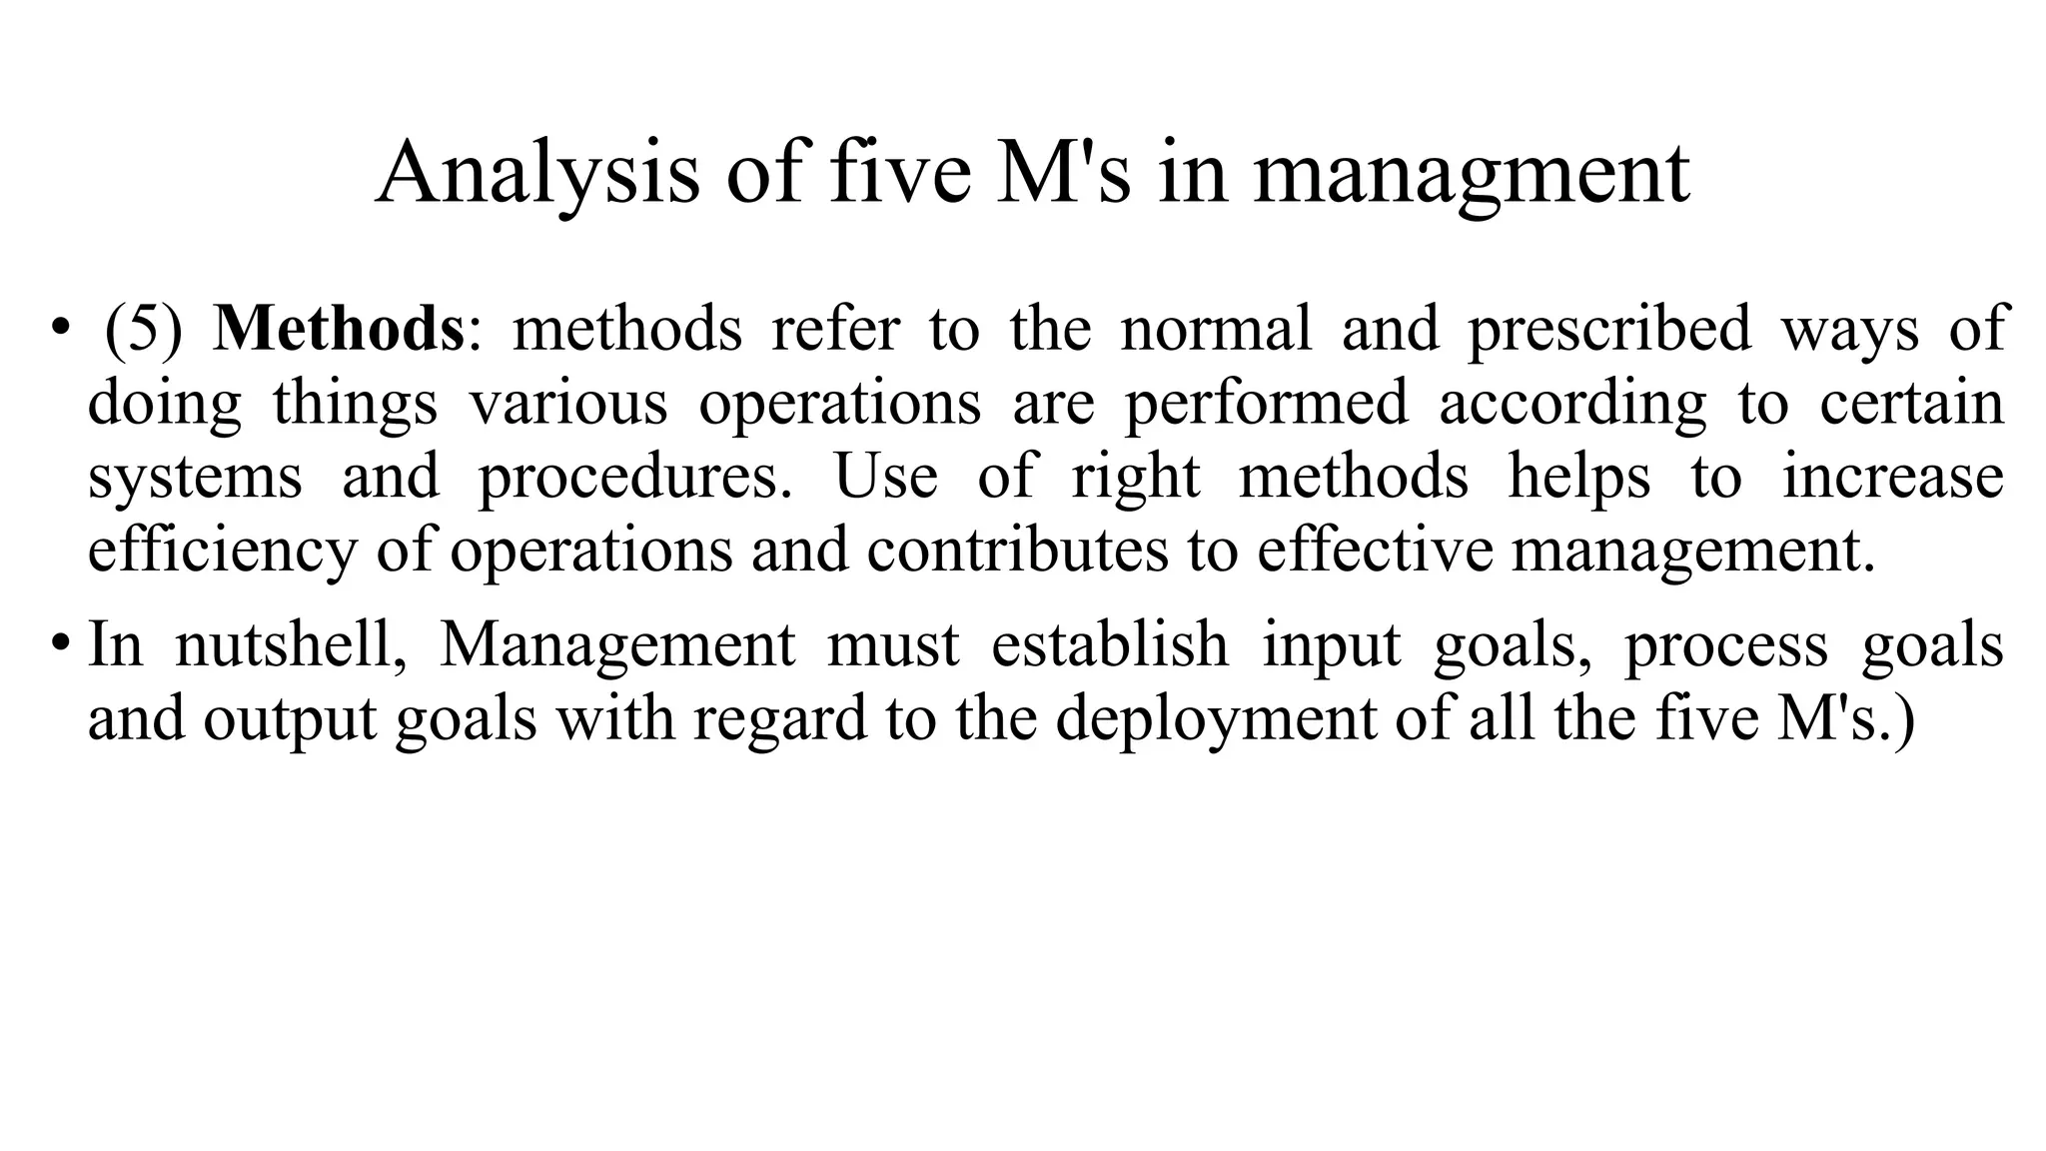

Slide 28
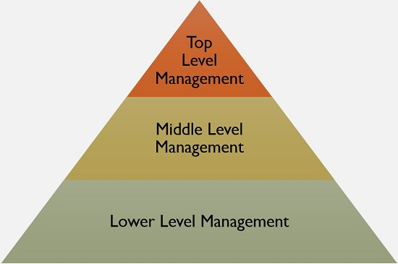
LEVELS OF MANAGEMENT

Slide 29
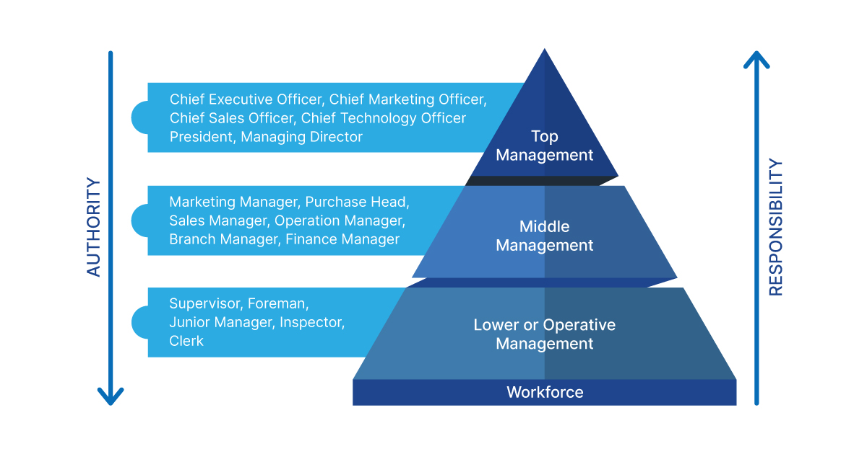

Slide 30
Top-Level Management: This is the highest level in the organizational hierarchy, which includes Board of Directors and Chief Executives. They are responsible for defining the objectives, formulating plans, strategies and policies.
Middle-Level Management : It is the second and most important level in the corporate ladder, as it creates a link between the top and lower level Management . It includes departmental and division heads and managers who are responsible for implementing and controlling plans and strategies which are formulated by the top executives.
Lower Level Management : Otherwise called as functional or operational level Management . It includes first line managers, foreman, supervisors. As lower level Management directly interacts with the workers, it plays a crucial role in the organization because it helps in reducing wastage and idle time of the workers, improving the quality and quantity of output.

Slide 31
ADMINISTRATIVE MANAGEMENT
Administrative management is also known as modern management. In 1916 Fayol published his book “Administration Industrielle et. General”. Later on, this book was translated into English version as “General and Industrial Management.” where he explained five important management functions: planning, organizing, commanding, coordinating, and controlling.
Henri Fayol analyzed the process of management and divided the activities of an industrial undertaking into six groups

Slide 32
ADMINISTRATIVE MANAGEMENT
Technical: Producing and manufacturing products
Commercial: Buying, selling and exchange
Financial: Search for optimal use of capital
Security: Protecting employees and property
Accounting: Recording and taking stock of costs, profits, liabilities, maintaining balance sheets and compiling statistics
Managerial: Planning, organizing, commanding, coordinating and controlling

Slide 33
HENRI FAYOL PRINCIPLES

Slide 34
Henri Fayol 14 principles
Division of Work
Authority and responsibility
Discipline
Unity of Command
Unity of Direction
Subordination of Individual Interest to Group Interest
Remuneration
Centralization of authority
Scalar Chain
Order
Equity
Stability of Tenure of Personal
Initiative
Esprit De Corps

Slide 35
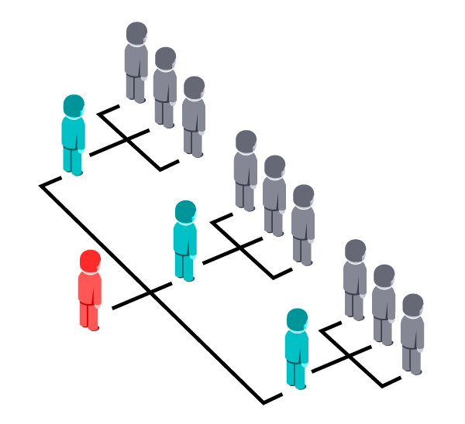
1.DIVISION OF WORK
The principle of division of work states that any work project must be divided into small tasks among workers based on their specialization. This division of work promotes achieving specialization in a skill.

Slide 36
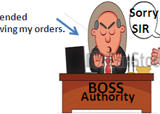
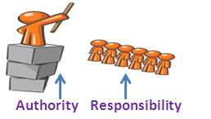
2.AUTHORITY AND RESPONSIBILITY
Authority is the right to give orders and obtain obedience, and responsibility is the corollary of authority.

Slide 37
3.DISCIPLINE
This principle states that discipline is required for any organization to run effectively. In order to have disciplined employees, managers need to build a culture of mutual respect. There should be a set of organizational rules, philosophies, and structures in place that should be met by everyone.

Slide 38
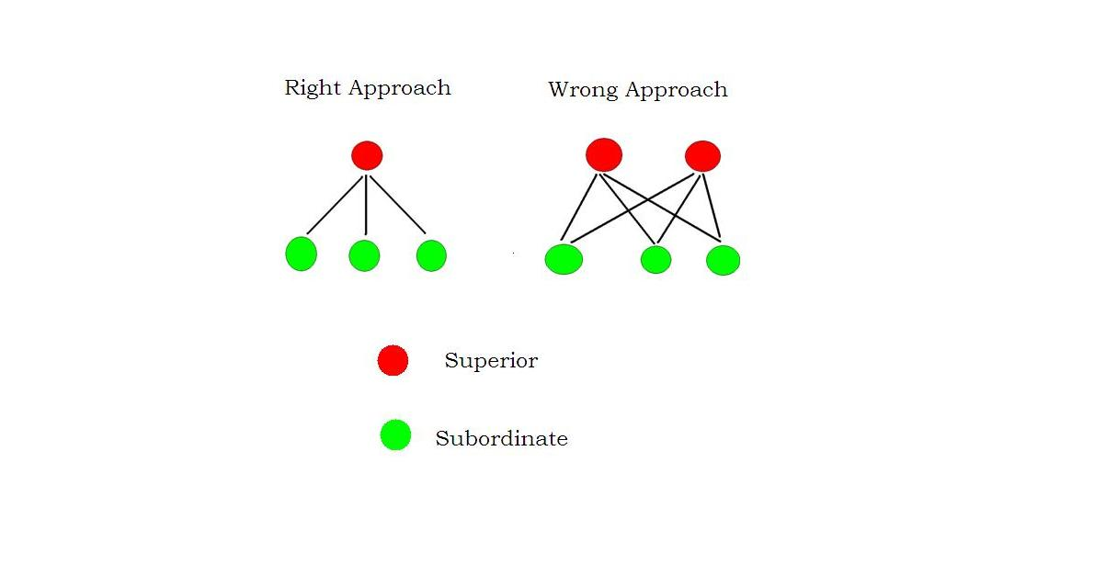
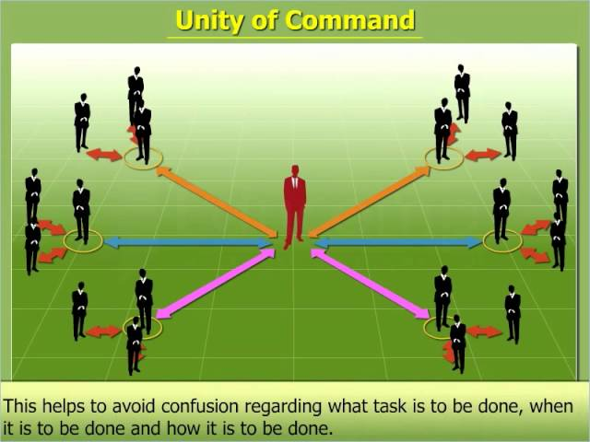
4.UNITY OF COMMAND
This principle states that that should be a clear chain of command in the organization. The employees should be clear on whose instructions to follow. According to Fayol, an employee should receive orders from only one manager. If an employee works under two or more managers, then authority, discipline, and stability are threatened. Moreover, this will cause a breakdown in management structure and cause employees to burn out.

Slide 39

5. UNITY OF DIRECTION
This henry fayol principle of management states that the work to be done should be organized in such a way that employees work in harmony towards the same objective, using one plan, under the direction of one manager.
For example, if you have a range of marketing activities such as advertising, budgeting, sales promotion, etc., there should be one manager using one plan for all the marketing activities. The different activities can be broken down for different sub-managers, but they should all work towards a common goal under the direction of one main person in charge of the whole thing.

Slide 40

6.SUBORDINATION OF INDIVIDUAL INTEREST TO GROUP INTEREST
The interests of any one employee or group of employees should not take precedence over the interests of the organization as a whole.

Slide 41

7.REMUNERATION
This henry fayol principle of management states that employees should be paid fair wages for the work that they carry out. Any organization that underpays its workers will struggle to motivate and keep quality workers. This remuneration should include both financial and non-financial incentives. Also, there should be a structure in place to reward good performance to motivate employees.

Slide 42
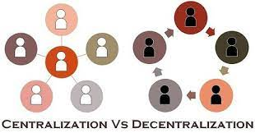
8.CENTRALIZATION
Centralization refers to the concentration of power in the hands of the authority and following a top-bottom approach to management. In decentralization, this authority is distributed to all levels of management. In a modern context, no organization can be completely centralized or decentralized.
Complete centralization means that people at the bottom have no authority over their responsibilities. Similarly, complete decentralization means that there will be no superior authority to control the organization. To use this effectively today, there should be a balance of centralization and decentralization. The degree to which this balance is achieved will differ from organization to organization.

Slide 43
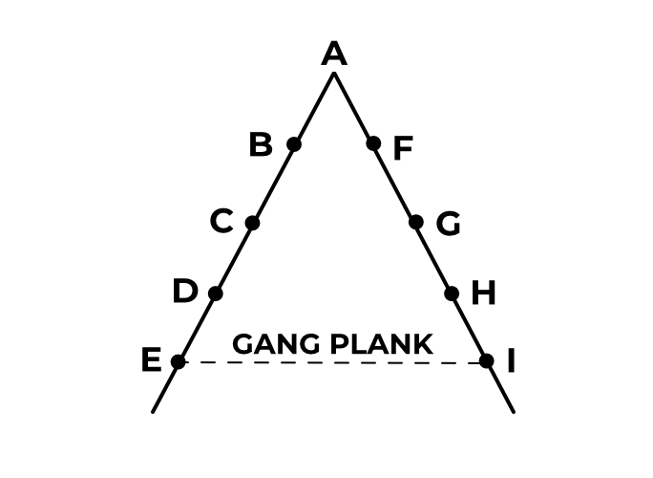
9. SCALAR CHAIN
According to this principle, there is a scalar chain of authority and communication that moves in a straight line from the superior to the lowest subordinate.
Henri Fayol permitted a shortcut of chain in case of urgency known as gang plank. Gang plank allows direct communication between two employees of the same level.

Slide 44


10.ORDER
This principle states that there should be an orderly placement of resources (manpower, money, materials, etc.) in the right place at the right time.
This ensures the proper use of resources in a structured fashion. Misplacement of any of these resources will lead to misuse and disorder in the organization.

Slide 45
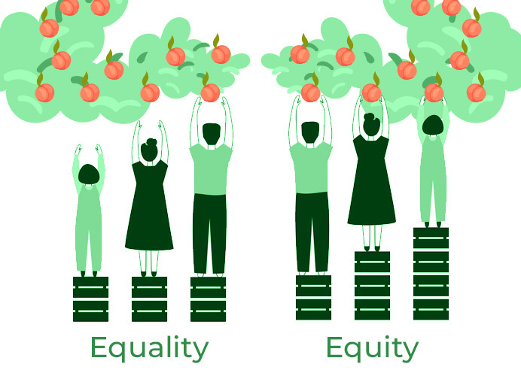
11.EQUITY
Equity is a combination of kindness and justice. This principle states that managers should use kindliness and justice towards everyone they manage. This creates loyalty and devotion among the employees towards the organization they work for.
Example: All employees, irrespective of gender, religion, race, and sexuality, must feel safe, seen, and heard and be given equal opportunities to grow and flourish in their careers within the organization.

Slide 46

12. STABILITY OF TENURE OF PERSONAL
Fayol said that employees should be kept in their position for a reasonable time to show result stability creates a sense of belonging, and workers are encouraged to improve their quality of work.
This will increase the efficiency of employees, and it will also increase the reputation of the organization.
Unnecessary labor turnover creates an atmosphere of disbelief.
Continuous changes in employees disturb the working environment.

Slide 47

13.INITIATIVE
Henri Fayol suggested that employees at all levels should be encouraged to take initiative in work.
It motivates employees to work better and to take more interest in the organization.
The initiative is a powerful motivator of human behavior and a source of strength for the organization.
This increase the mental growth and feeling of belongingness in employees.
It increases the commitment of employees toward the organization.

Slide 48

14. Esprit de Corps
Esprit de Corps means “Team Spirit”. This henry fayol principle of management states that the management should strive to create unity, morale, and co-operation among the employees.
Team spirit is a great source of strength in the organization.
Happy and motivated employees are more likely to be productive and efficient.

Slide 49
TAYLOR’S SCIENTIFIC MANAGEMENT THEORY

Slide 50
PRINCIPLES OF SCIENTIFIC MANAGEMENT
In the last century, organizations already had to deal with management in practice. In the early 1900s, large organizations, such as production factories, had to be managed too. At the time there were only few external management tools, models and methods available.

Slide 51
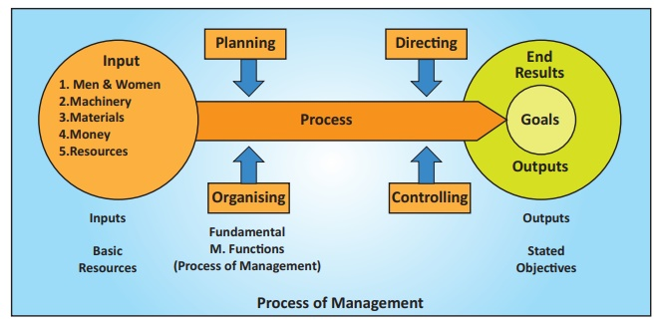

Slide 52
FREDERICK WINSLOW TAYLOR :-
Scientific management may be defined as the “Art of knowing exactly what is to be done and the best way of doing it”.
Frederick Winslow Taylor (1856-1915) was an American mechanical engineer and a consultant who proposed the concept of scientific management under the name ‘The Principles of Scientific Management’ in the year 1911. He was also known as the ‘Father of Scientific Management’.
Taylor made observations regarding the inexcusable work methods in the companies like Bethlehem Steel, Simonds Rolling Machine and Midvale Steel.

Slide 53
Taylor found that the organizations and the managers failed to utilize the available human resources effectively, and also, no contribution was made in the direction of enhancing the labour’s efficiency.
Based on his findings, Taylor criticized the ineffective ways of the managers to handle the work situations and also for providing liberty to the employees for deciding their work methods and speed by themselves.

Slide 54
PRINCIPLES OF SCIENTIFIC MANAGEMENT
Science, Not Rule of Thumb
Harmony, Not Discord
Cooperation, Not Individualism
Development of each and every person to his or her
greatest efficiency and prosperity.

Slide 55
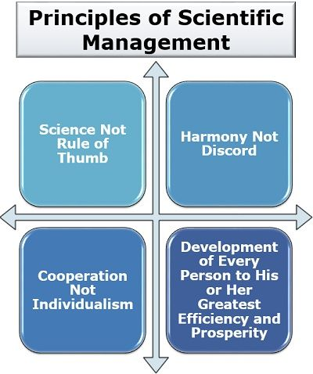

Slide 56
SCIENCE NOT RULE OF THUMB
In order to increase organisational efficiency, the ‘Rule of Thumb’ method should be substituted by the methods developed through scientific analysis of work.
Rule of Thumb means decisions taken by manager as per their personal judgments. According to Taylor, even a small production activity like loading iron sheets into box cars can be scientifically planned. This will help in saving time as well as human energy. Decisions should be based on scientific enquiry with cause and effect relationships.
This principle is concerned with selecting the best way of performing a job through the application of scientific analysis and not by intuition or hit and trial methods. The work assigned to any employee should be observed and analyzed with respect to each element or part thereof and the time involved therein so as to decide the best way of performing that work and to determine the standard output for same.

Slide 57
HARMONY, NOT DISCORD
Taylor emphasized that there should be complete harmony between the workers and the management since if there is any conflict between the two, it will not be beneficial either for the workers or the management. Both the management and the workers should realize the importance of each other
Management should always be ready to share the gains of the company with the workers and the latter should provide their full cooperation and hard work for achieving organizational goals.
It becomes possible by
(a) sharing a part of surplus with workers
(b) training of employees,
(c) division of work
(d) team spirit
(e) positive attitude
(f) sense of discipline
(g) sincerity etc.

Slide 58
COOPERATION, NOT INDIVIDUALISM
This principle is an extension of principle of ‘Harmony, not discord’ and lays stress on mutual cooperation between workers and the management. Cooperation, mutual confidence, sense of goodwill should prevail among both, managers as well as workers. The intention is to replace internal competition with cooperation. Both ‘Management’ and ‘Workers’ should realize the importance of each other.
Workers should be considered as part of management and should be allowed to take part in decision making process of the management. Management should always welcome their suggestions and should also reward them if their suggestions prove to be beneficial for the organisation viz. reduction of costs or increase in production etc.
At the same time, workers should also resist from going on strike or making unnecessary demands from management.
Workers should be treated as integral part of organisation and all important decisions should be taken after due consultation with workers.

Slide 59
DEVELOPMENT OF EACH AND EVERY PERSON TO HIS OR HER GREATEST EFFICIENCY AND PROSPERITY
Taylor believed that employees should be given proper training of the task they perform because no human being is perfect, and there is always a scope of improvement.
Efficiency of any organisation also depends on the skills and capabilities of its employees to a great extent. Thus, providing training to the workers was considered essential in order to learn the best method developed through the use of scientific approach.
To attain the efficiency, steps should be taken right from the process of selection of employees. Employees should be scientifically selected.
The work assigned to each employee should suit his/her physical, mental and intellectual capabilities.
Efficient employees produce more to earn more. This ultimately helps to attain efficiency and prosperity for both organisation and the employees.
The Principles of Taylor’s Scientific Management Theory became widely practiced, and the resulting cooperation between workers and managers eventually developed into the teamwork we enjoy today.

Slide 60
MAYO’S MANAGEMENT THEORY

Slide 61
HUMAN RELATIONS PERIOD
Human relations period is characterized by the focus on the human factor in dealing with business and production issues. The researchers and practicing executives concentrate more on issues such as human behavior at the workplace, motivation, group relationships, and leadership.

Slide 62
MAYO’S MANAGEMENT THEORY
George Elton Mayo was an Australian born psychologist, industrial researcher, and organizational theorist. Mayo was known for his famous experiment at the Hawthorne Plant of the Western Electric Company, Chicago, USA, for evaluating the attitudes and psychological reaction of workers on the job situations.
Mayo’s management theory states that employees are motivated far more by relational factors such as attention and camaraderie than by monetary rewards or environmental factors, such as lighting, humidity and more.

Slide 63
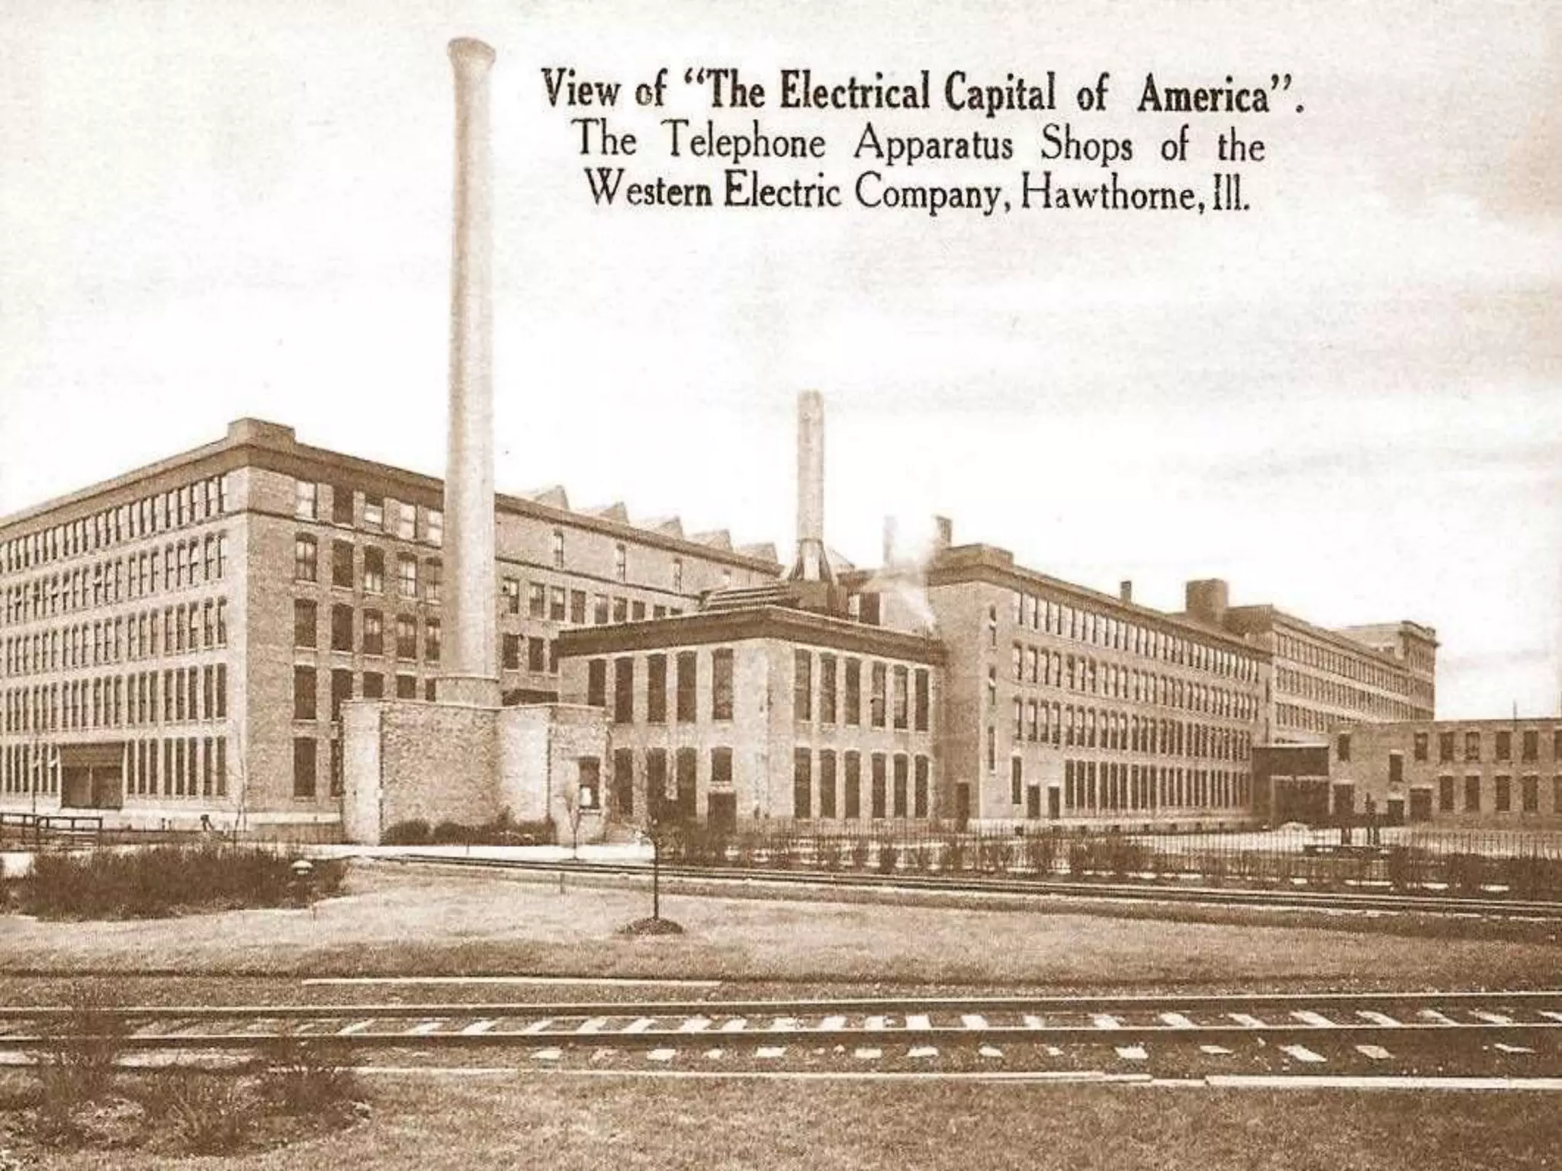

Slide 64
MAYO’S MANAGEMENT THEORY
.It ended as a series of studies into social factors: membership of work groups, informal relationship with the supervisors, and so on.
It revealed that workers valued most the social relations at work, and these were viewed as important as monetary incentives and good physical working conditions.
The study demonstrated that the influence of groups in determining behaviour at work can be very powerful.

Slide 65
THE HAWTHORNE EXPERIMENTS
In one of the Hawthorne experiments, Mayo’s research team examined changes in the amount of light available in the work area.
The results were confusing at first. When the lighting was increased, output rose; on the other hand, when the light was decreased, output still rose.
An analysis of this and other such puzzling results showed that the workers were highly motivated more for the importance given to them.
The reduction in light did not affect their work.
What mattered to them was that they were really making a contribution to company operations and this fact is being recognised by the top management.

Slide 66
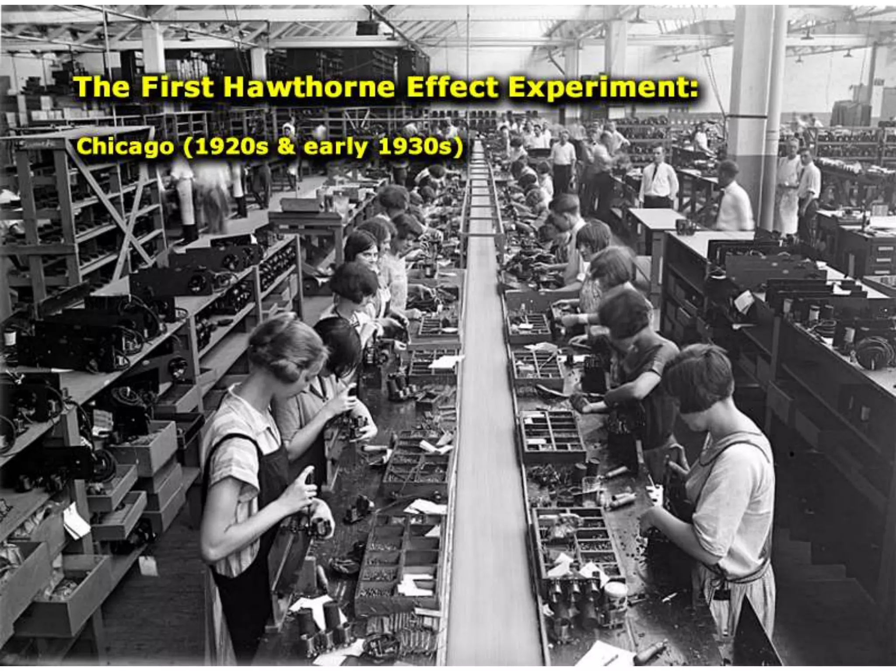

Slide 67
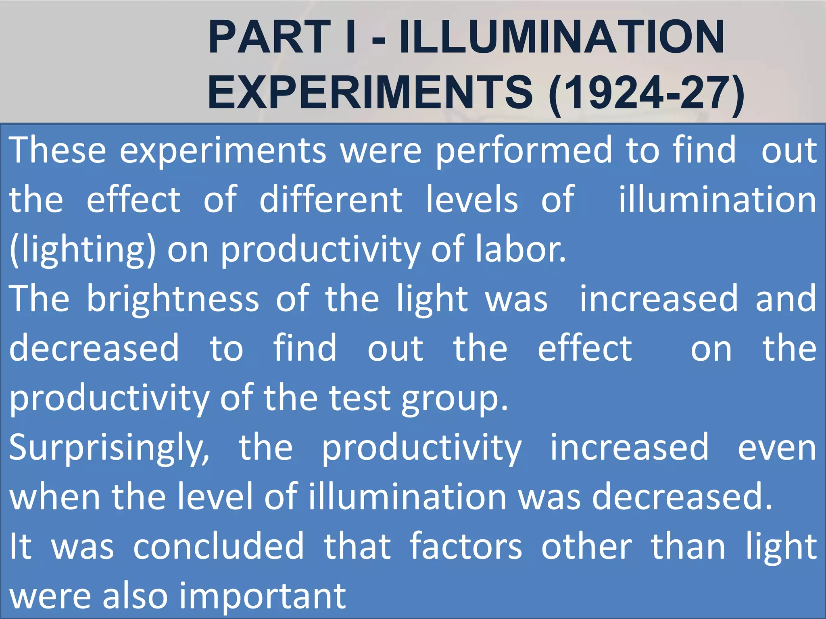

Slide 68
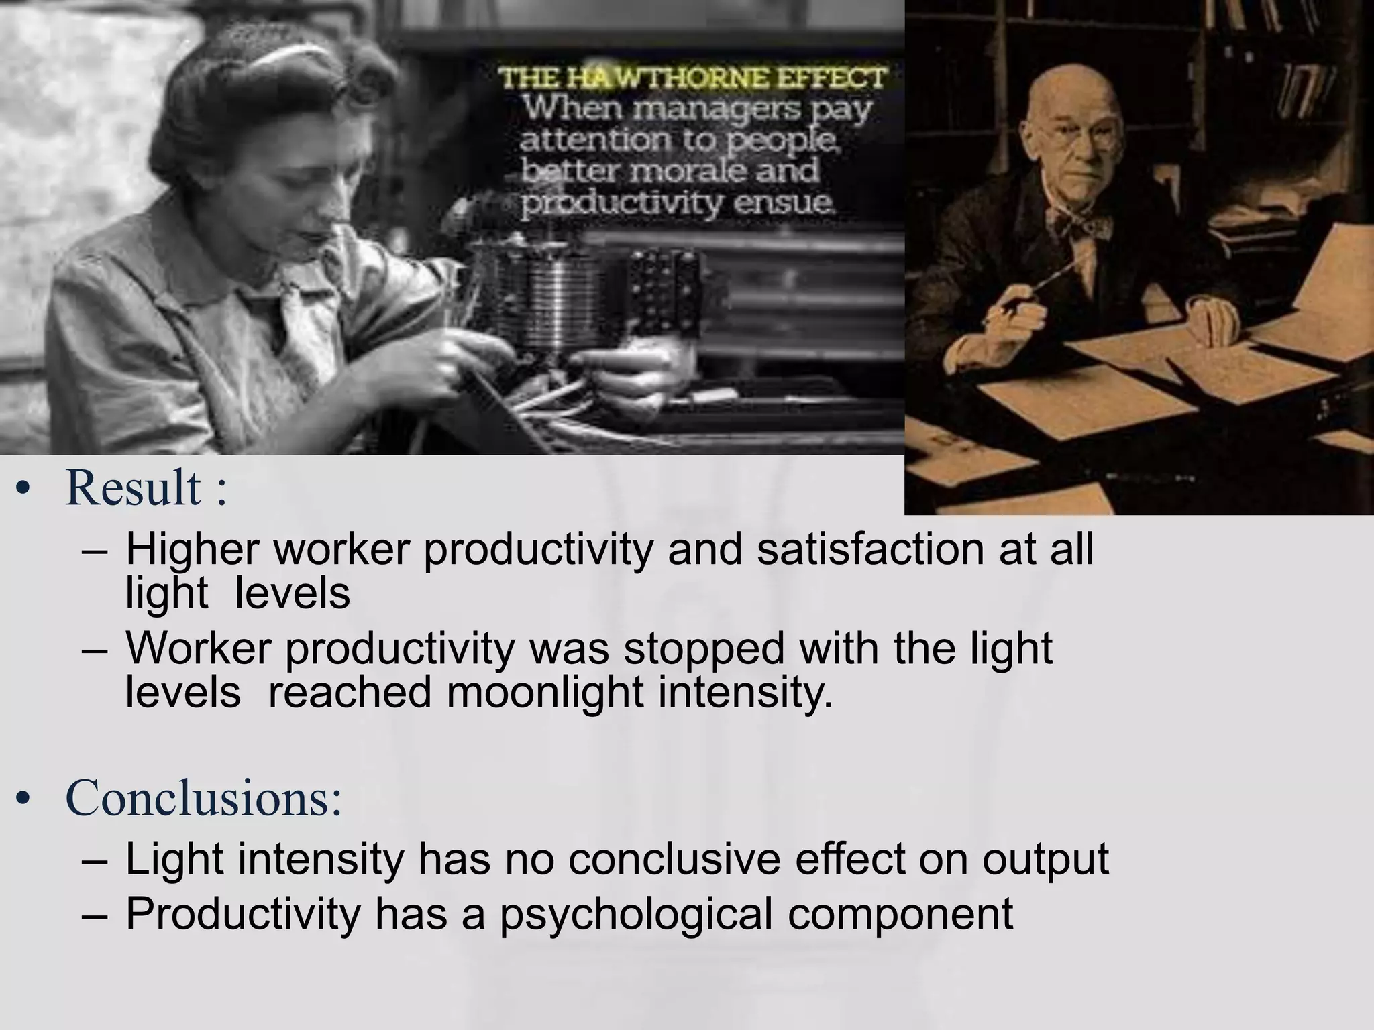

Slide 69
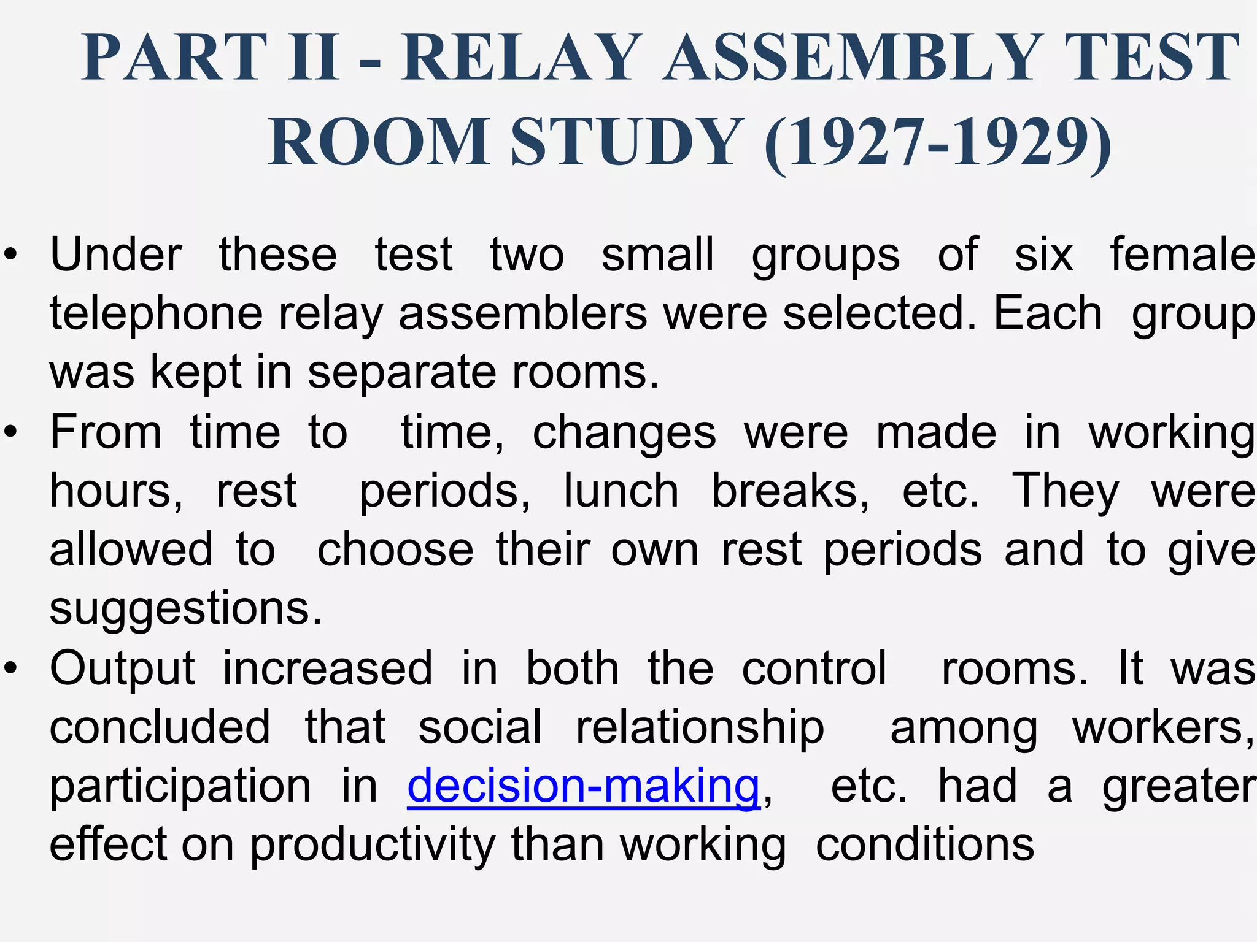

Slide 70
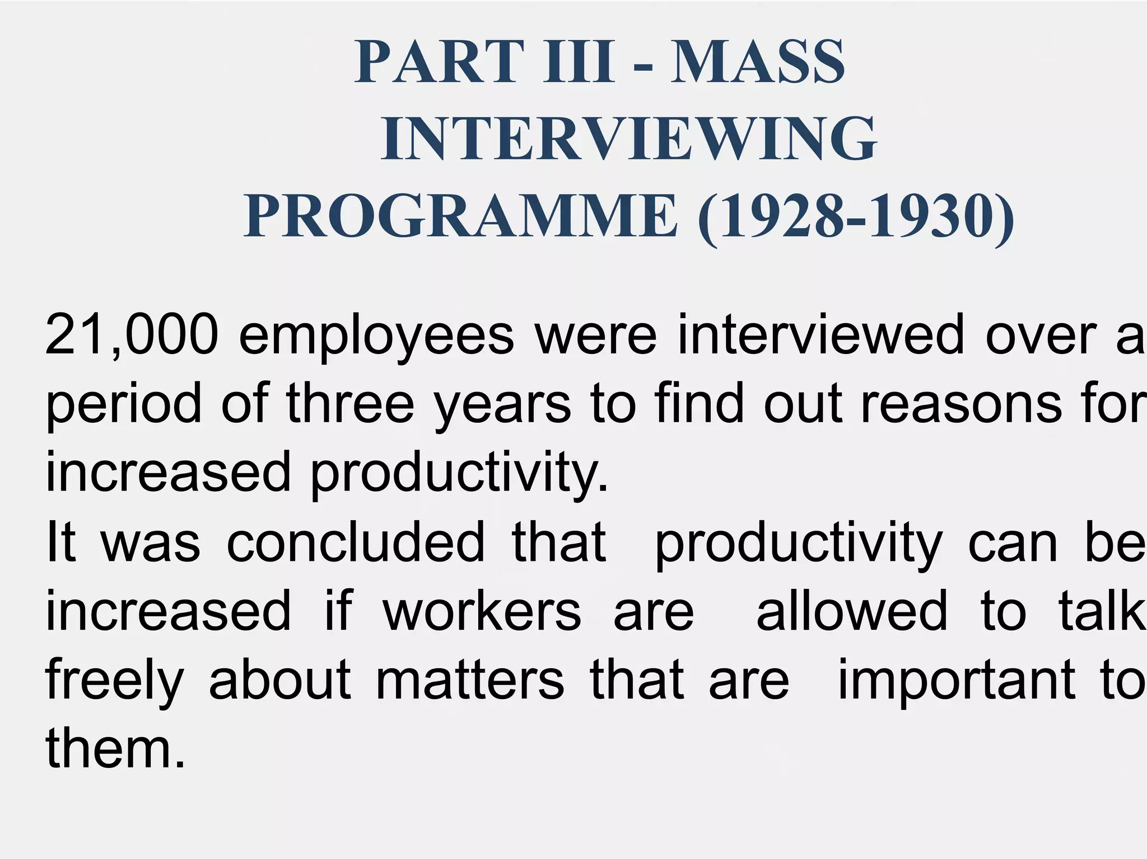

Slide 71
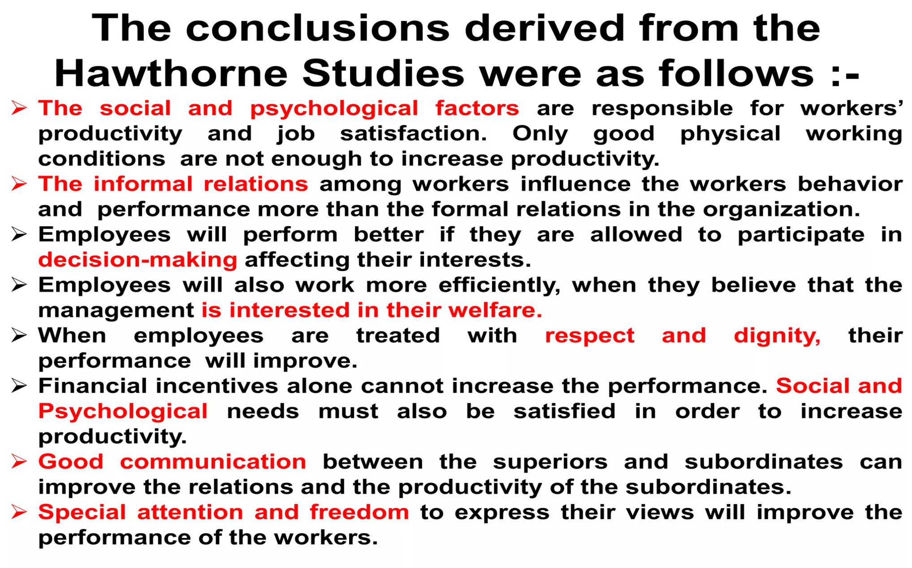

Slide 72
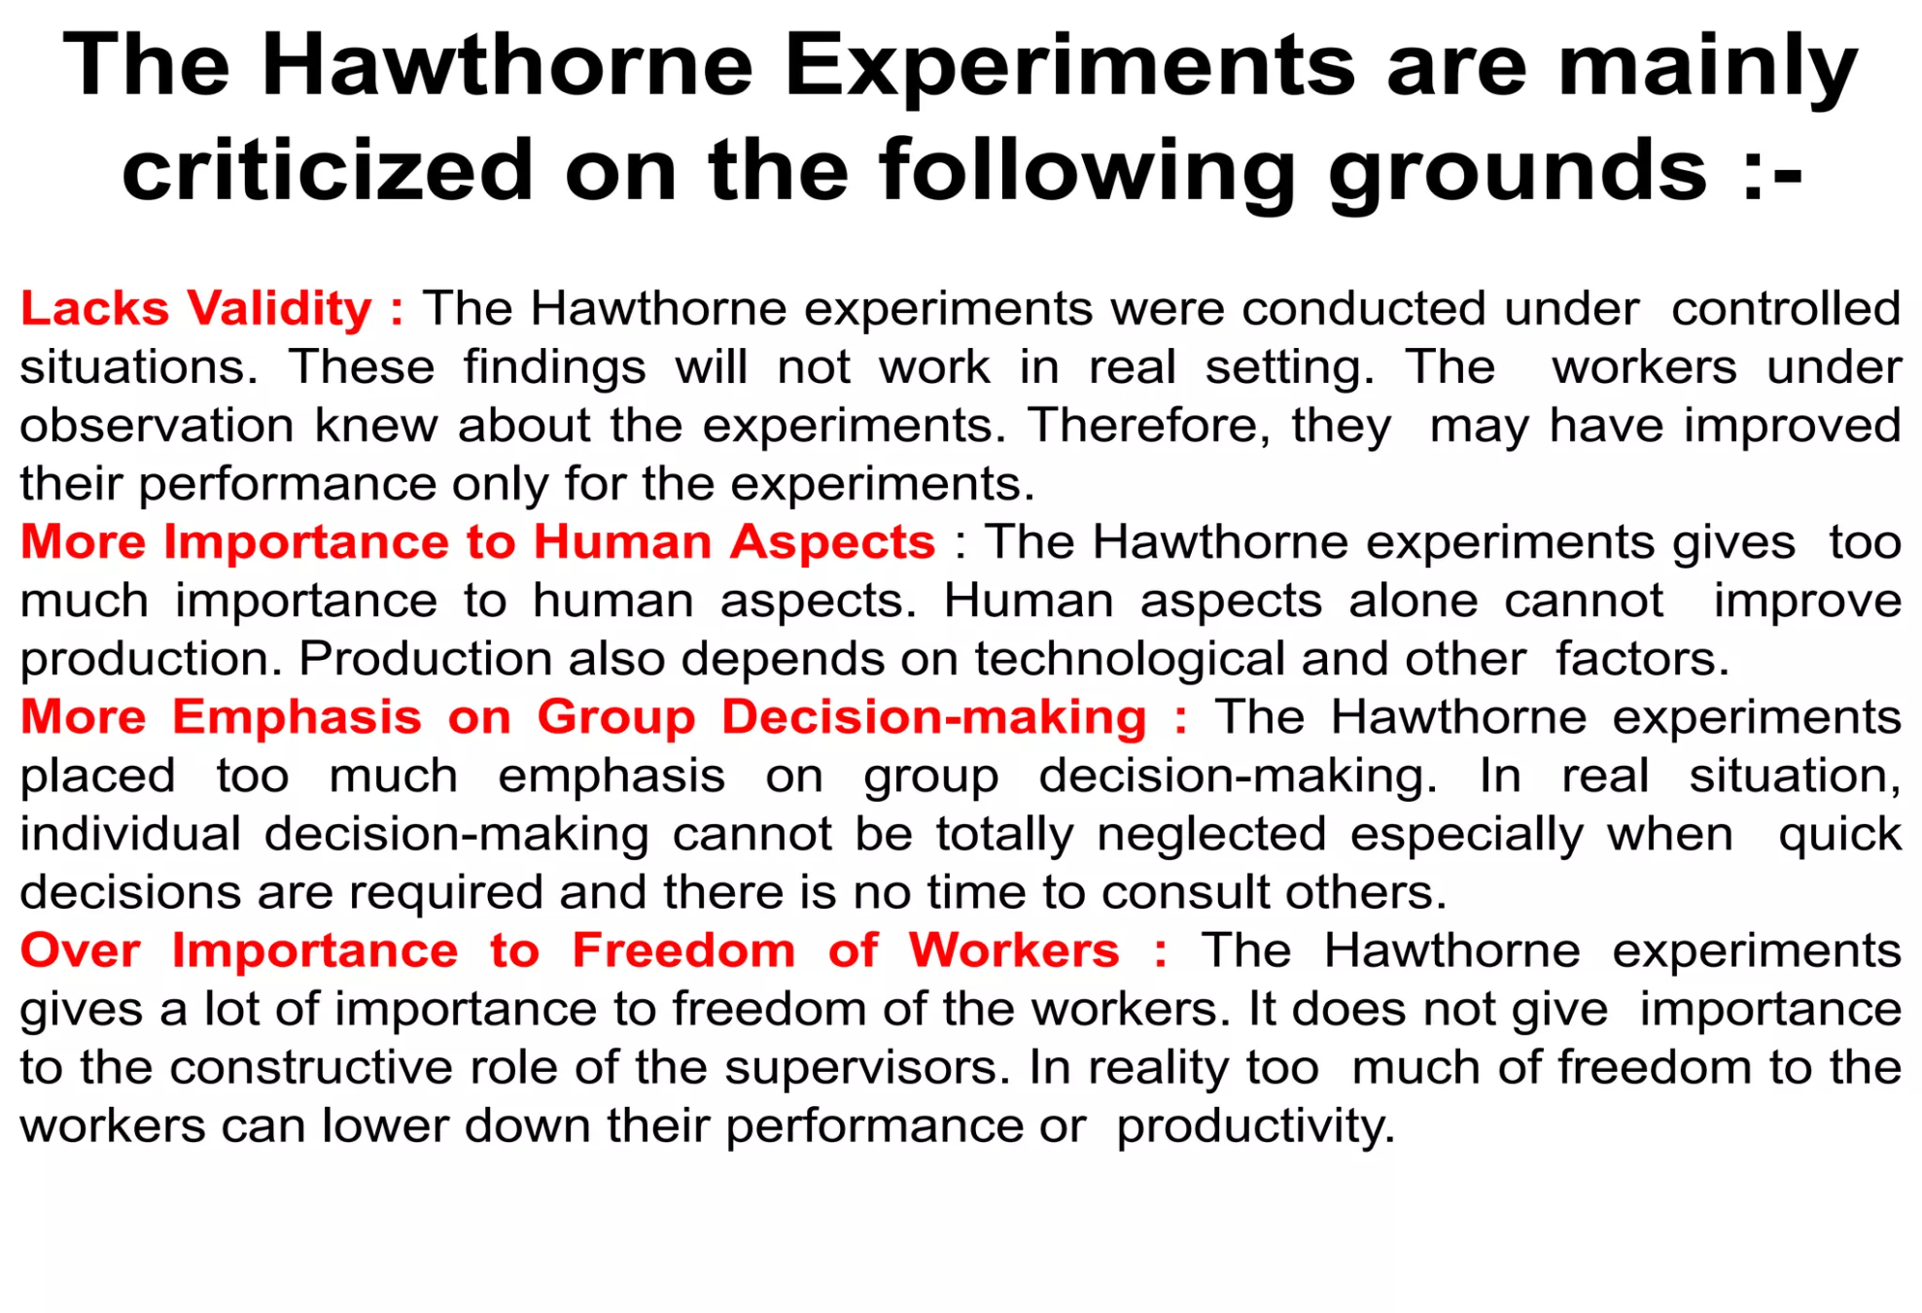

Slide 73
Managers have responsibility for motivating individuals and their teams. Important elements of this include:
Communicating and explaining the vision, values and strategy to all team members so everyone is working to the same level.
Providing appropriate training and induction for new employees as well as coaching for all in order to develop skills, confidence and self-reliance.
Carrying out one-to-one meetings and employee reviews to assess performance and set personal and team objectives.
Putting in place succession planning for the team and manager roles to ensure long term performance.

Slide 74
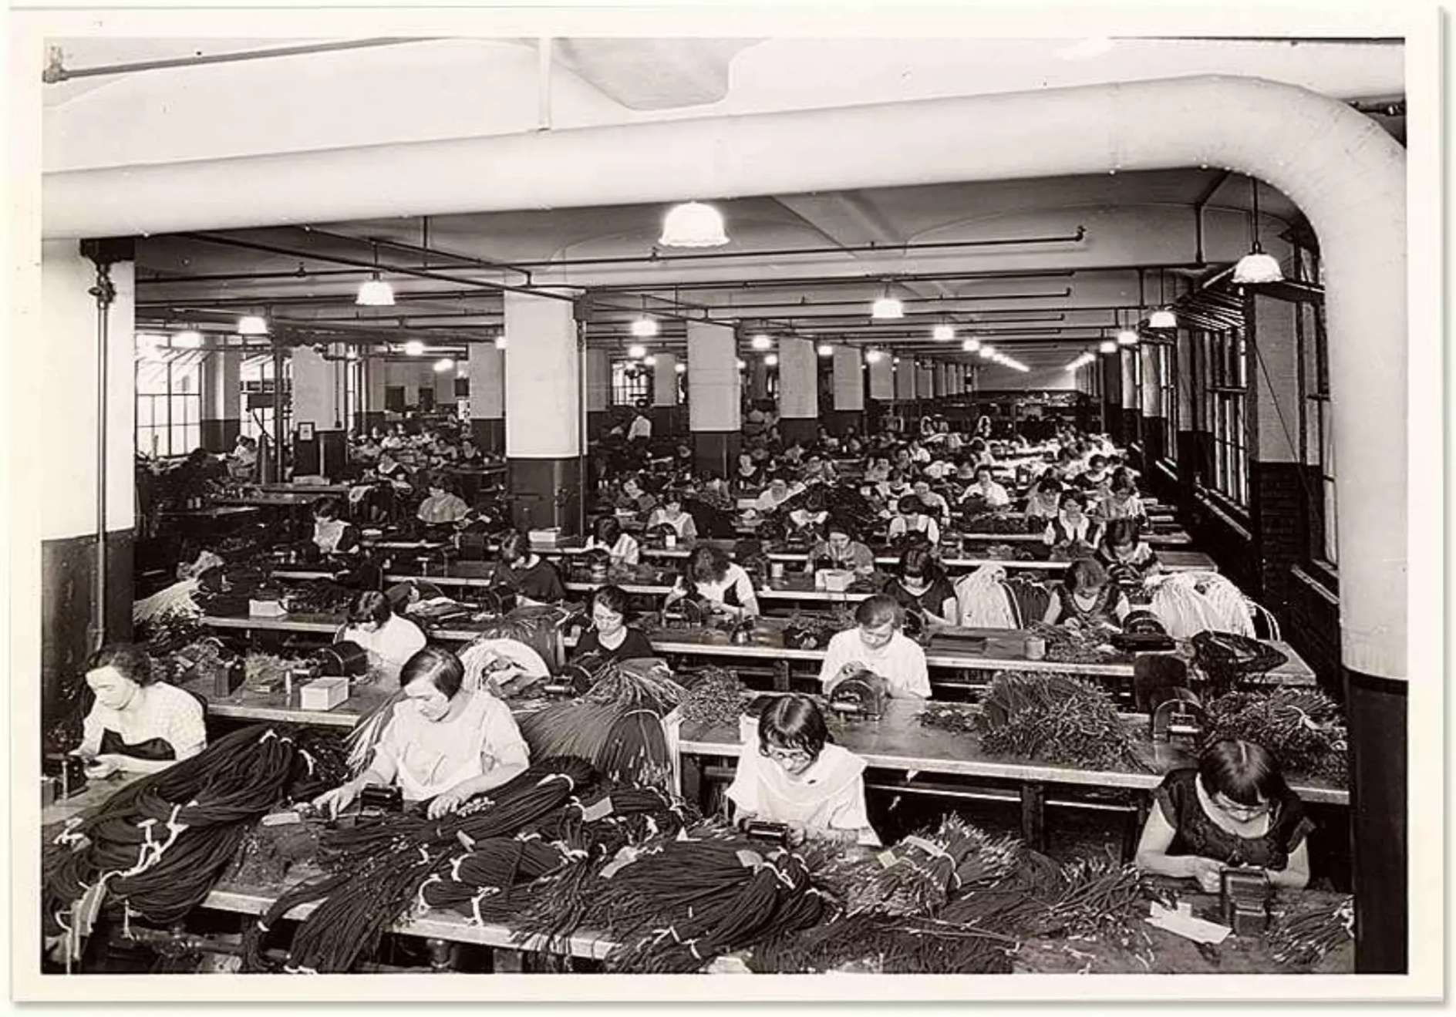

Slide 75
The sense of belongingness and effective management were the two secrets unfolded by the Hawthorne experiments. The workers enjoyed more the sense of belongingness, as evident from their high morale and functional interrelationships among the members of a group. The management was effective in terms of understanding human relationships among workers, particularly groups. The way the workers were motivated, counselled, led, and communicated proved very effective. This highlights the recognition of the human factor and constitutes the essence of the ‘Hawthorne effect’.

Slide 76
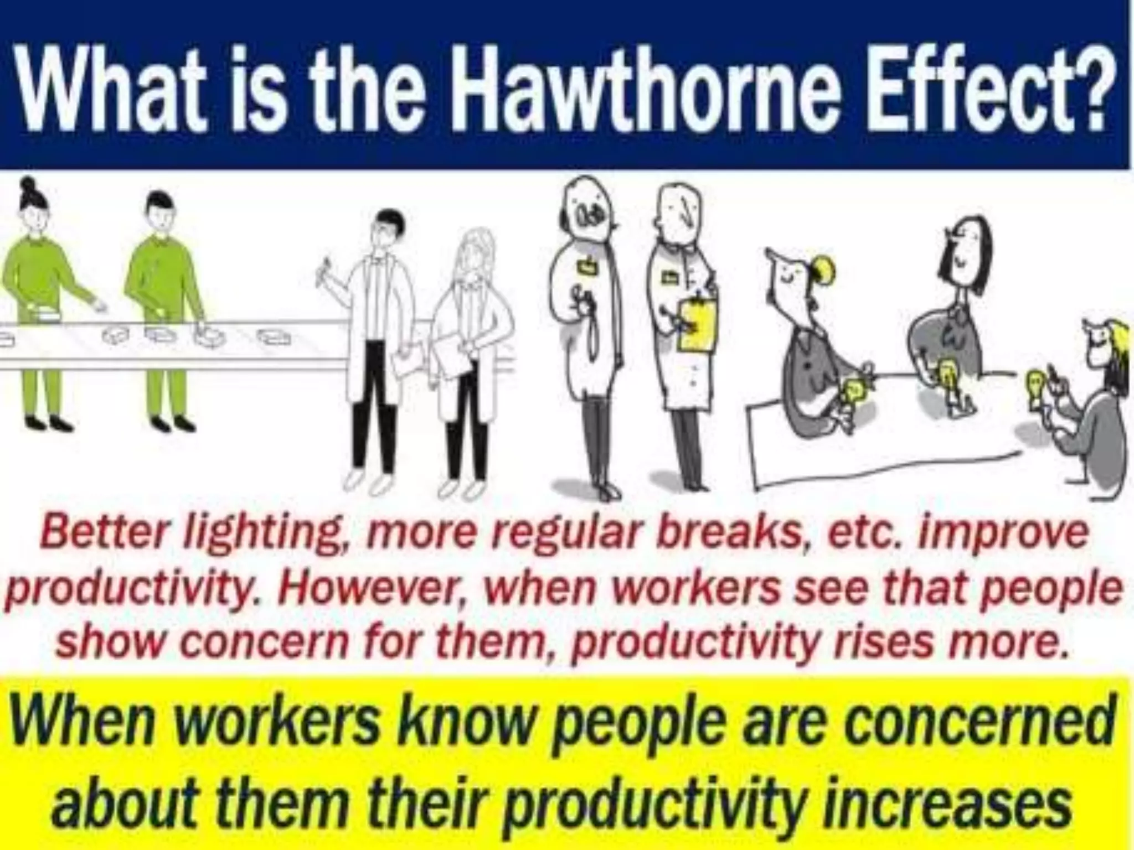

Slide 77
MASLOW’S THEORY

Slide 78
Maslow's Hierarchy of Needs Theory
In a 1943 paper titled "A Theory of Human Motivation," American psychologist Abraham Maslow theorized that human decision-making is undergirded by a hierarchy of psychological needs. In his initial paper and a subsequent 1954 book titled ‘Motivation and Personality’, Maslow proposed that five core needs form the basis for human behavioral motivation.
Maslow's theory presents his hierarchy of needs in a pyramid shape, with basic needs at the bottom of the pyramid and more high-level, intangible needs at the top. A person can only move on to addressing the higher-level needs when their basic needs are adequately fulfilled.

Slide 79
5 LEVELS OF MASLOW’S HIERARCHY OF NEEDS
Physiological needs
Safety needs
Love and belonging needs
Esteem needs
Self-actualization needs

Slide 80
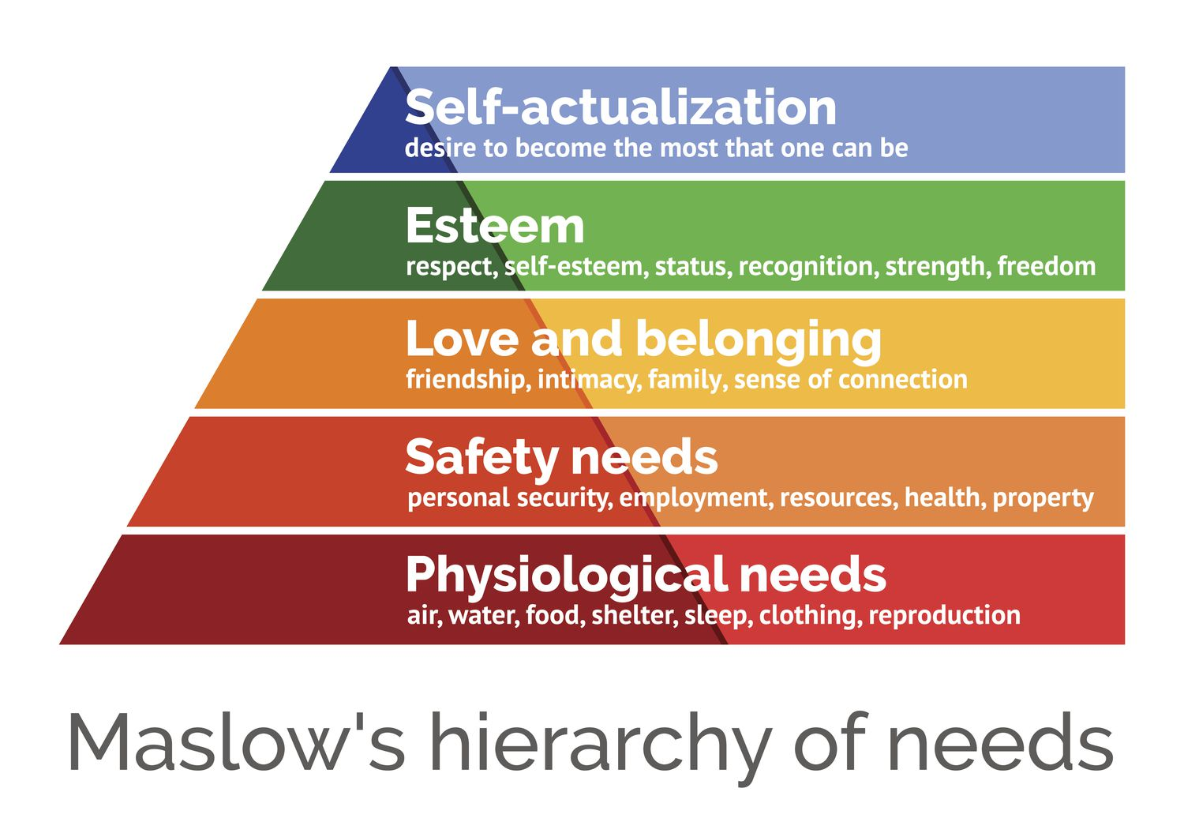

Slide 81
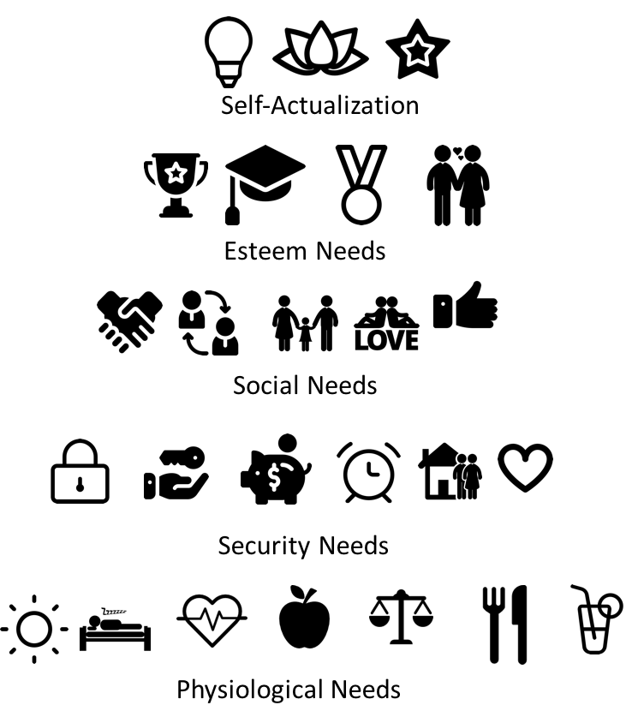

Slide 82
1.Physiological needs: Include need for food, sleep, warmth, shelter, sex, and others. These are basic needs and if these are not satisfied, one does not think of needs at the higher level.
2. Safety needs: Safety needs are also called security needs. These cover security, protection, job security, safety of property, availability of food or shelter on a continuing basis, and so on.
3. Love and belonging needs:
The social needs on the third level of Maslow’s hierarchy relate to human interaction and are the last of the so-called lower needs. Among these needs are friendships and family bonds—both with biological family (parents, siblings, children) and chosen family (spouses and partners). Physical and emotional intimacy ranging from sexual relationships to intimate emotional bonds are important to achieving a feeling of elevated kinship. Additionally, membership in social groups contributes to meeting this need, from belonging to a team of coworkers to forging an identity in a union, club, or group of hobbyists.

Slide 83
4. Esteem needs:
Maslow states that one does not stop with affiliation or acceptance needs. One goes one step beyond. One wants to be respected and garlanded. To satisfy the esteem needs, people want to feel more prestigious, politically very strong and powerful, or enjoy better status.
5. Self-actualization needs:
Self-actualization needs include education, skill development—the refining of talents in areas such as music, athletics, design, cooking, and gardening—caring for others, and broader goals like learning a new language, traveling to new places, and winning awards. Finally, when he is successful in the exports, he feels that he has achieved what he is capable of achieving! What he has achieved is the self-actualisation need.

Slide 84
https://www.simplilearn.com/principles-of-management-by-henri-fayol-article#:~:text=3.-,Discipline,should%20be%20met%20by%20everyone.
https://www.geeksforgeeks.org/14-principles-of-management-by-henri-fayol/
https://theinvestorsbook.com/scientific-management.html
https://www.slideshare.net/pgp4149/elton-mayo-ppt
https://www.masterclass.com/articles/a-guide-to-the-5-levels-of-maslows-hierarchy-of-needs

